Slide 1
Newsroom Math for Cronkite Students

Slide 3
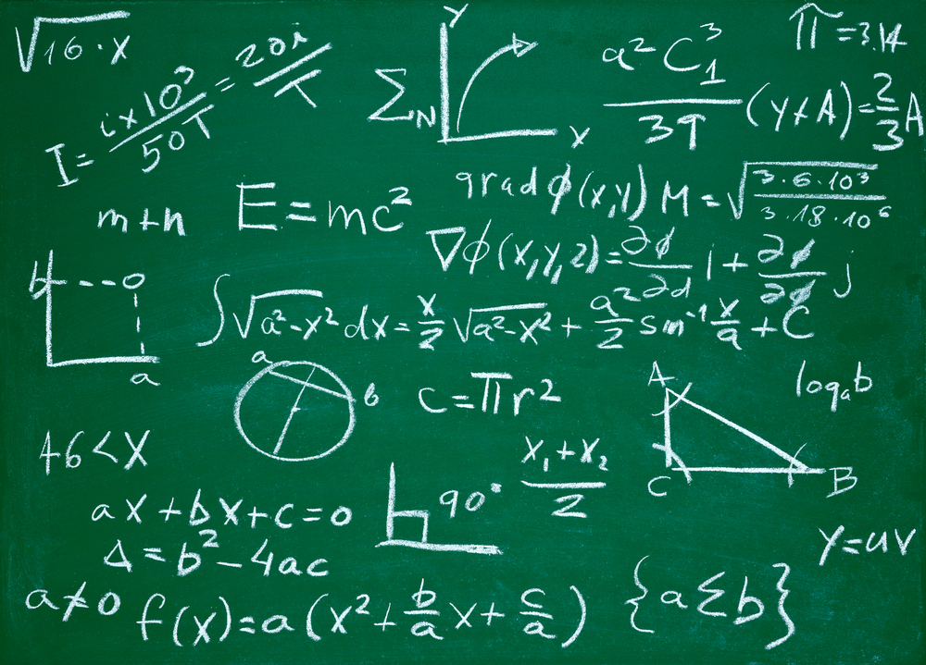

Slide 4
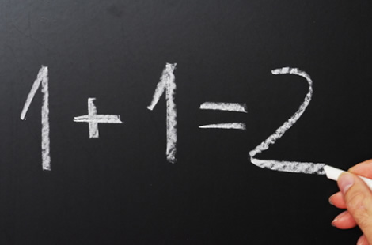

Slide 5
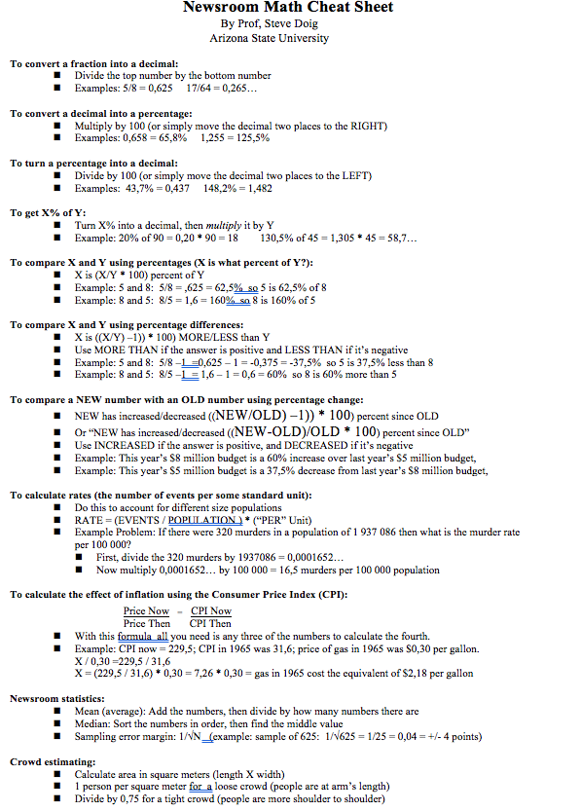
Newsroom Math
4-function math: add, subtract, multiply, divide
Percent
Fractions and ratios
Percentage change
Rates: crimes, etc.
Mean, median, maximum, minimum, range
Consumer price index
Estimate crowds
Polling error margins (1/√n)
Property tax
Calculating ages

Slide 6
The plan : This summer
Doig will prepare 3-4 short newsroom math video lessons.
Doig will prepare a set of newsroom math exercises to go with each lesson.
Doig will develop a newsroom math “final” with a large bank of questions that can be randomized.

Slide 7
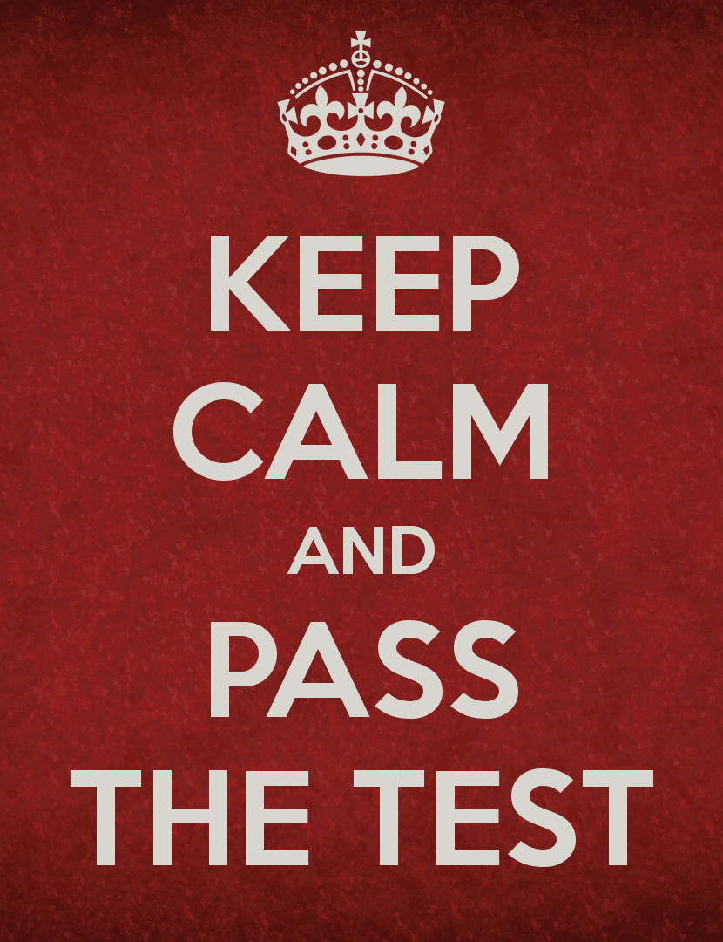
The plan for JMC201: Fall 2017
All Cronkite students in JMC201 will take a newsroom math pre-test at the beginning of the semester. (We’ll use these results for assessment.)
All Cronkite students in JMC201 will be required to pass a newsroom math test by getting 100% correct.
Those who don’t pass will be encouraged to watch the videos and do the exercises, then retake the test.
Students can take the newsroom math test multiple times until they pass at the 100% correct level. (Yes, the questions will change.)

Slide 8
The plan: Into the future
Beyond JMC201, students need regular reminders that newsroom math skills are necessary.
To that end, we want instructors in 301, 315 and our other skills courses to put math questions into every news quiz.
Instructors in those courses will be given a large collection of pre-built and answered math questions.

